Slide 1





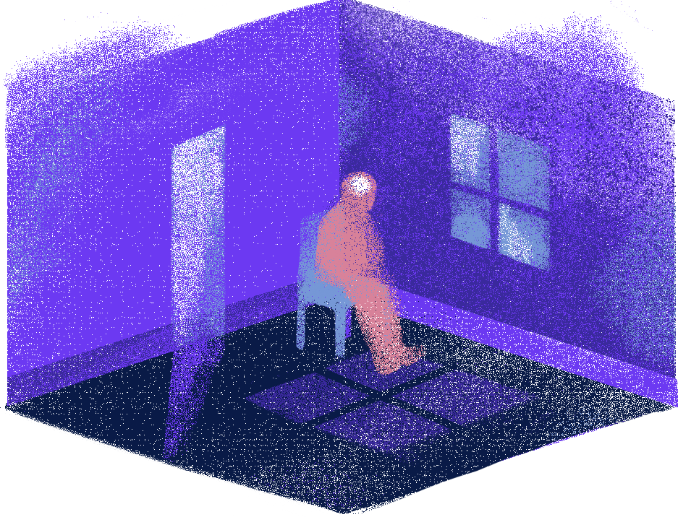

SafeSpace
AI-Based Mental Health Companion

Slide 2

INTRODUCTION
Millions of people struggle with stress, anxiety, and depression without access to proper support. SafeSpace is a free AI-powered mental health companion that helps users assess their mental well-being and receive personalized guidance in both Arabic and English.

Slide 3

OUR MOTIVATION
WHY SAFESPACE?
• Rising rates of stress, anxiety, and depression.
• Limited and costly mental health services.
• Social stigma around seeking help.
• Lack of Arabic-supported mental health platforms.
• Need for accessible, AI-powered mental health support.

Slide 4




PROJECT STATEMENT
01
02
03
04
Inaccurate self-reported assessments
Lack of root-cause analysis
Limited Arabic language support
Absence of real-time crisis detection

Slide 5



OUR SOLUTIONS
Intelligent Mental Health Assessment
Personalized Recommendation System
Continuous Monitoring
& Early Detection

Slide 6



User Input
Survey Model
Survey (42Q)
+ Free text
Dense NN
DASS-42
Fusion Layer
NLP Model
Weighted avg=
40%. NLP + 60% .Survey
XLM-RoBERTa
(Arabic + English)
Output
SYSTEM ARCHTICTURE
Scores +
Recommendations

Slide 7
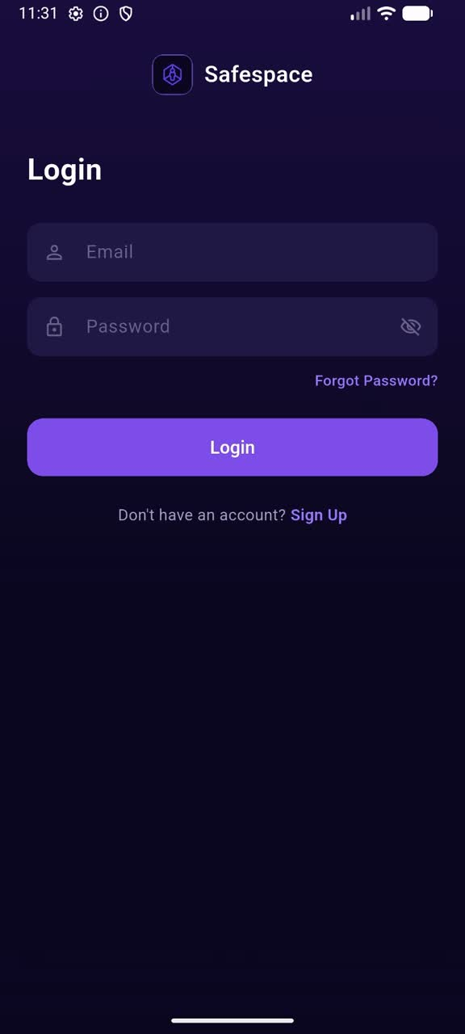
LIVE DEMO

Slide 8
MENTAL HEALTH AI
AI-powered Psychological Assessment System

Slide 9

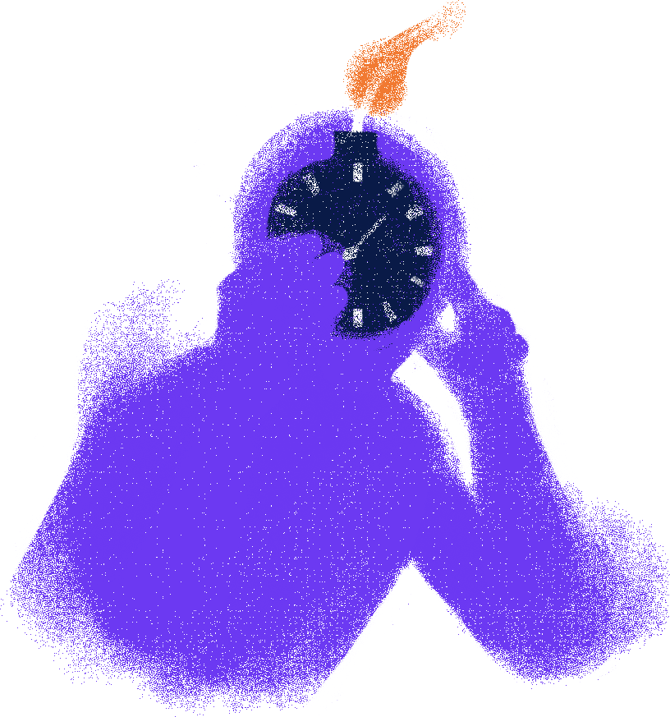
DATA PREPROCESSING
3 Classes
Depression · Anxiety · Stress
39,775
29,361
Survey samples
DASS-42 open dataset
NLP text samples
MentalHealth-Darija dataset

Slide 10



SURVEY MODEL
39,775
172
Total respondents
Original columns
42
Feature columns used

Slide 11

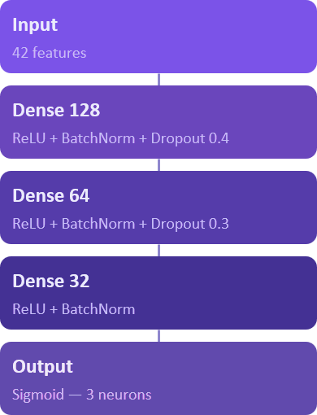
SURVEY MODEL
0.997
R² Score

Slide 12

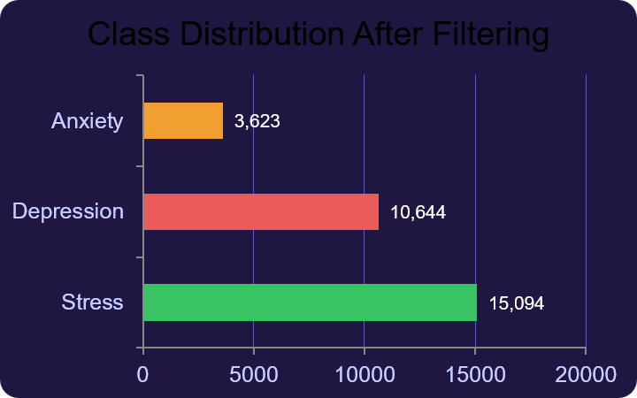
NLP MODEL
51,093
29,361
2
Original samples
Filtered
(3 classes)
Languages (AR + EN)

Slide 13
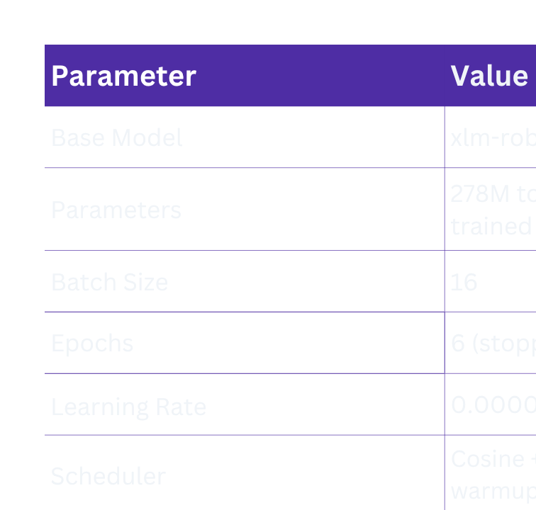
NLP MODEL

Slide 14
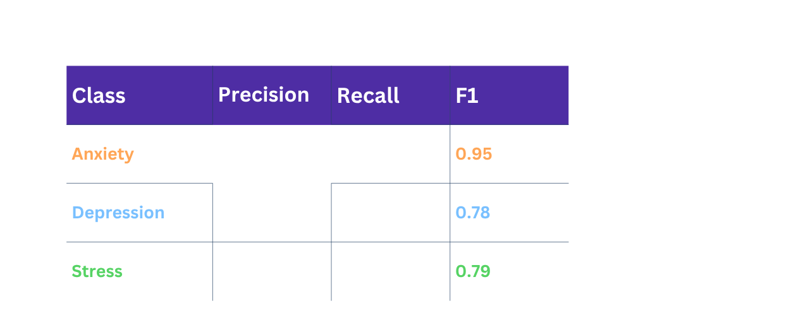
NLP MODEL
83.01%
0.839
0.3215
Base model
Overall Accuracy
Macro F1 Score
XLM-RoBERTa
Eval Loss

Slide 15
MODEL FUSION
final_score[c]=
0.4 × NLP_score[c] + 0.6 × Survey_score[c]
Why 60% Survey?
Why 40% NLP?
Structured, standardised psychometric tool. Validated clinically — DASS-42 has 30+ years of use
Captures nuanced language not in survey items. Captures nuanced language not in survey items

Slide 16
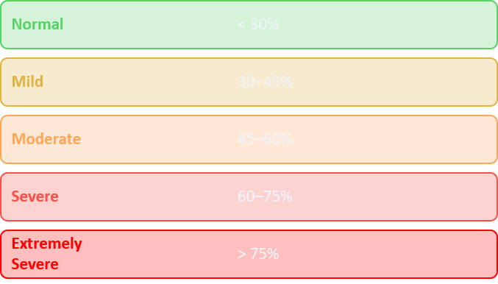

RECOMMENDATIONS ENGINE
Severity Thresholds
Output per Report
4+ practical tips (EN + AR)
2+ resources (EN + AR)
Referral advice
Severity badge
Crisis hotlines if needed

Slide 17

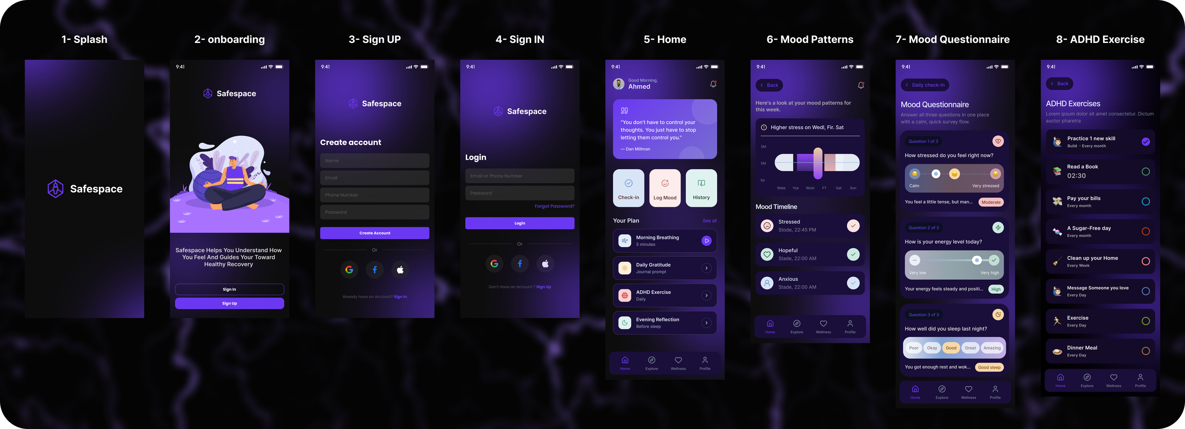
UX/UI DESIGN

Slide 18
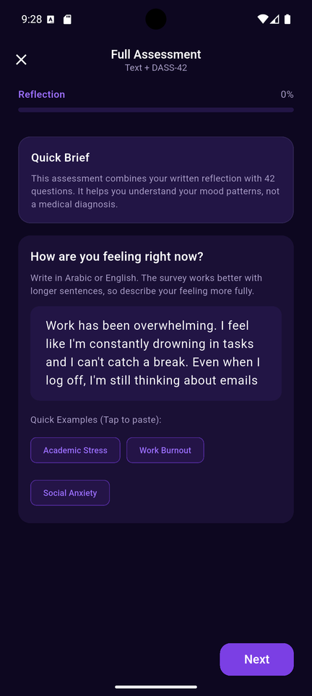
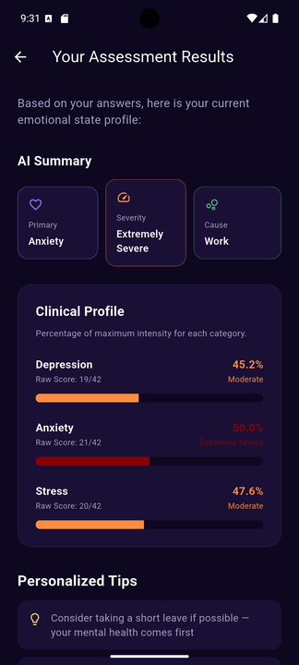
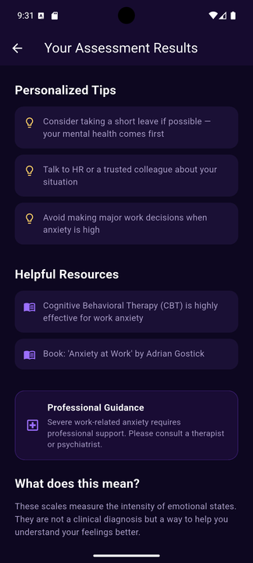
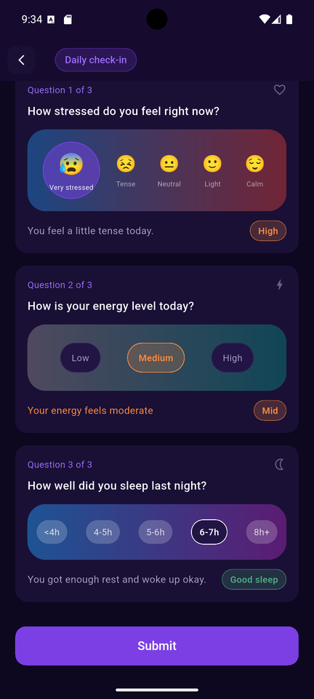
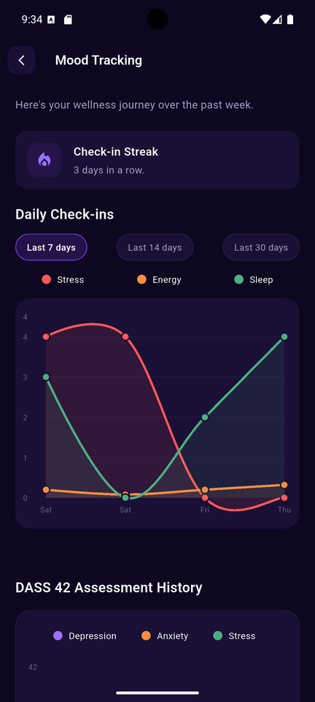
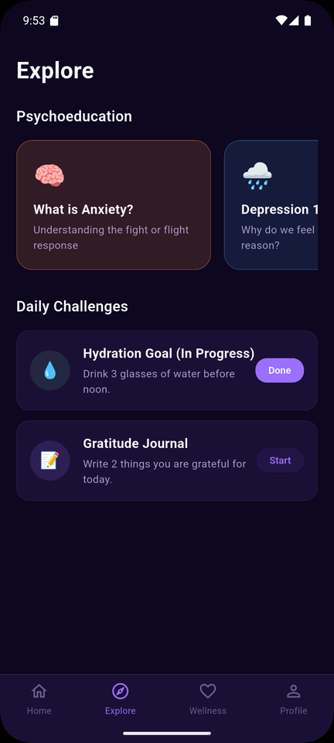
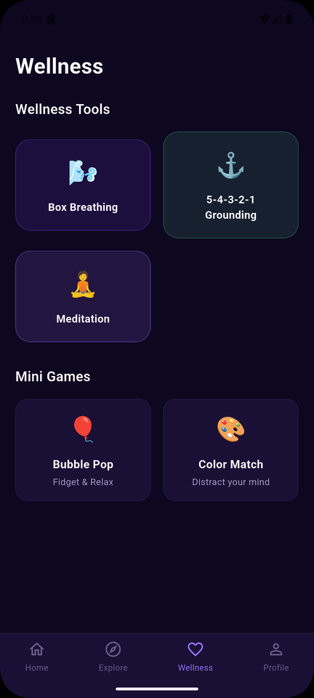
UX/UI DESIGN
NLP WITH TEXT
ASSESSMENT RESULT OVERVIEW
DAILY CHECK IN SUBMIT
MOOD TRACKER STATS
ASSESSMENT RESULT TIPS
PSYCHOEDUCATION OVERVIEW
WELLNESS TOOLS MENU

Slide 19
FLUTTER
01
02
03
04
MOOD MONITORING
SYSTEM
RESPONSIVE
& MODULAR UI
ARCHITECTURE
BACKEND &
AI INTEGRATION
USER AUTHENTICATION

Slide 20
DATABASE & BACKEND ARCHITECTURE

Slide 21
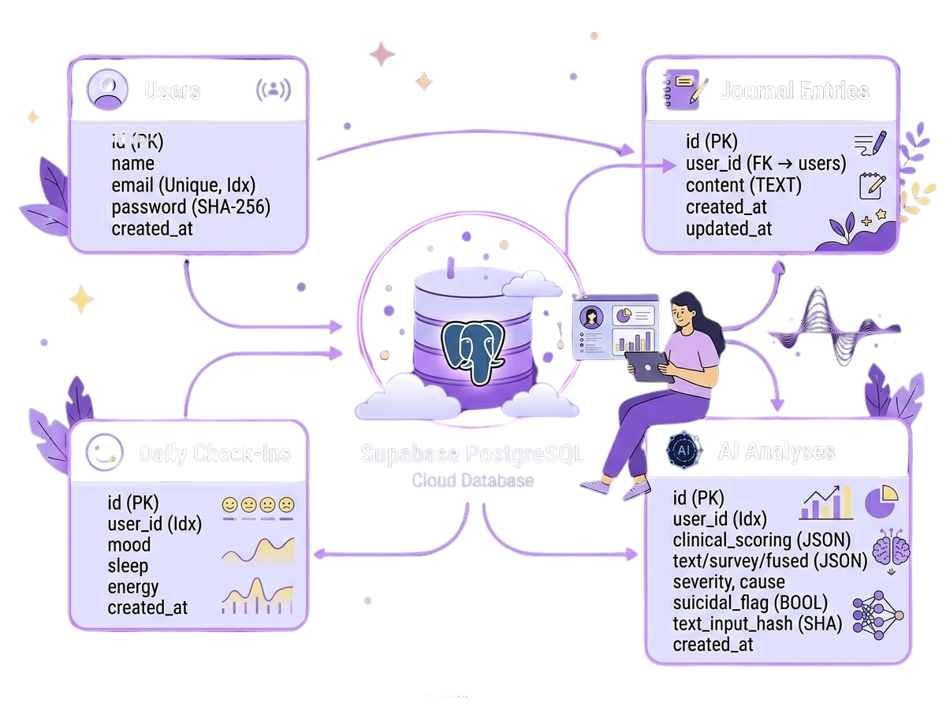
DATABASE
  Supabase : a secure cloud vault where all the data are stored safely.
  SQLAlchemy ORM : It translates Python commands into SQL.
  Four Core Tables: users, check-ins, journal entries, analyses.
  Security & Performance : we generate secure SHA-256 hashes of text inputs

Slide 22
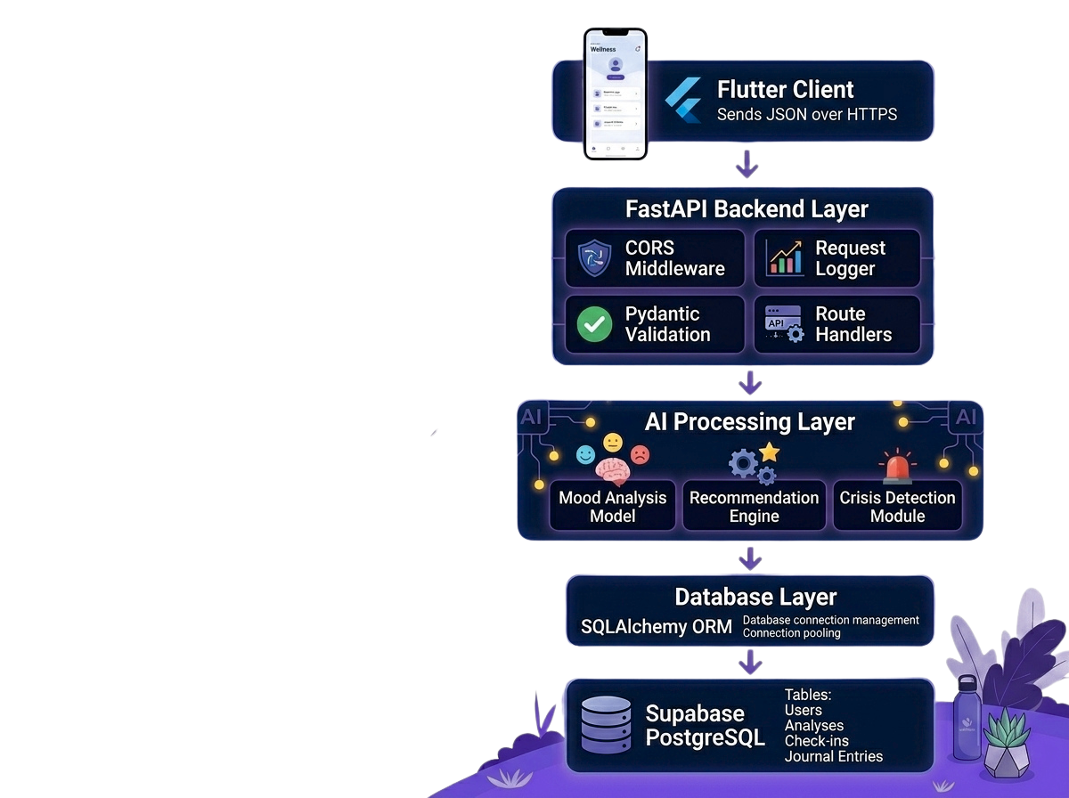
BACKEND
  Python FastAPI Framework : a modern, high-performance web framework for building APIs with Python
  NumPy forward-pass :Instead of loading large machine learning frameworks on our cloud servers , we wrote a custom NumPy forward-pass that loads the model weights directly. This processes the DASS-42 survey in milliseconds.
  15+ REST API Endpoints: Support authentication, assessments, check-ins, journals, and AI analysis.

Slide 23
CLOUD DEPLOYMENT
& HOSTING

Slide 24
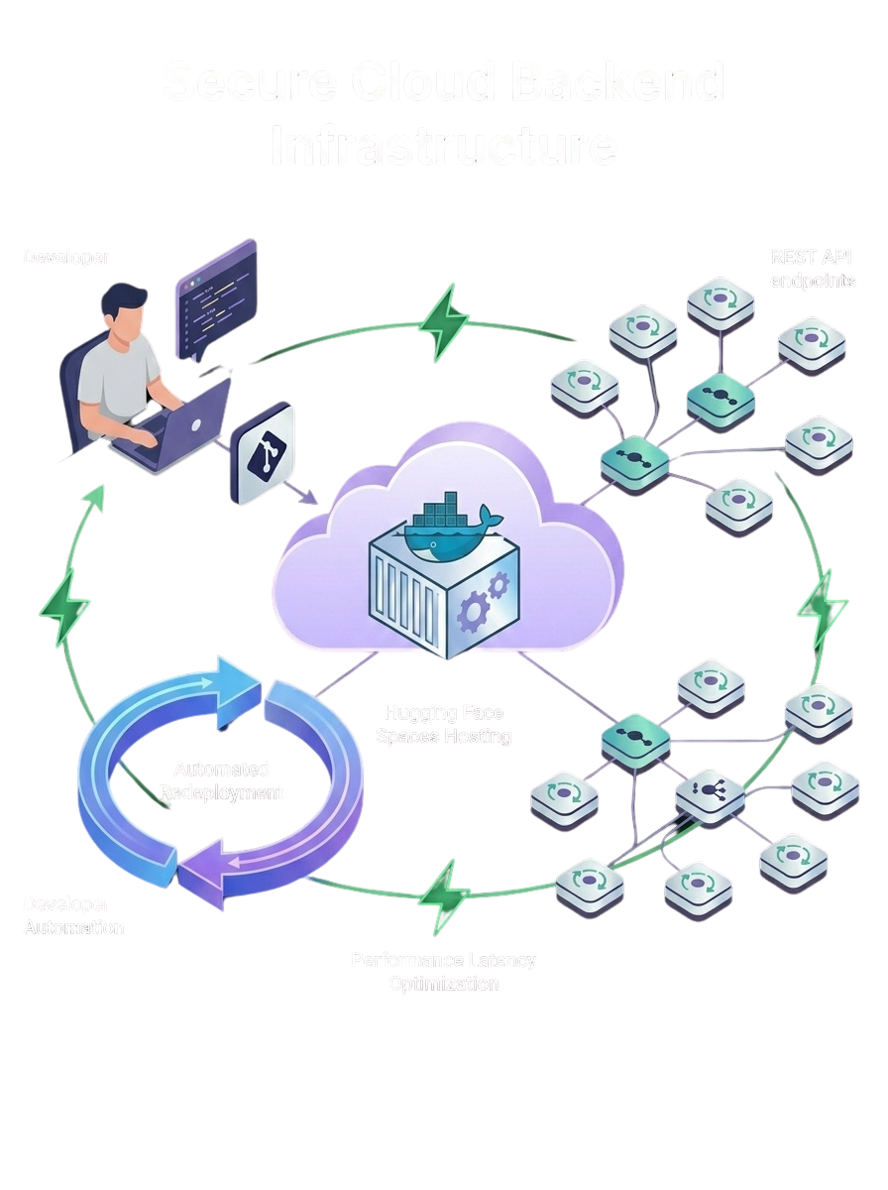
HOSTING
  Cloud Deployment: Dockerized backend on Hugging Face Spaces.
  Automated Updates: Auto rebuild and redeploy on code changes.
  Performance Optimization: Model caching and faster AI inference.

Slide 25
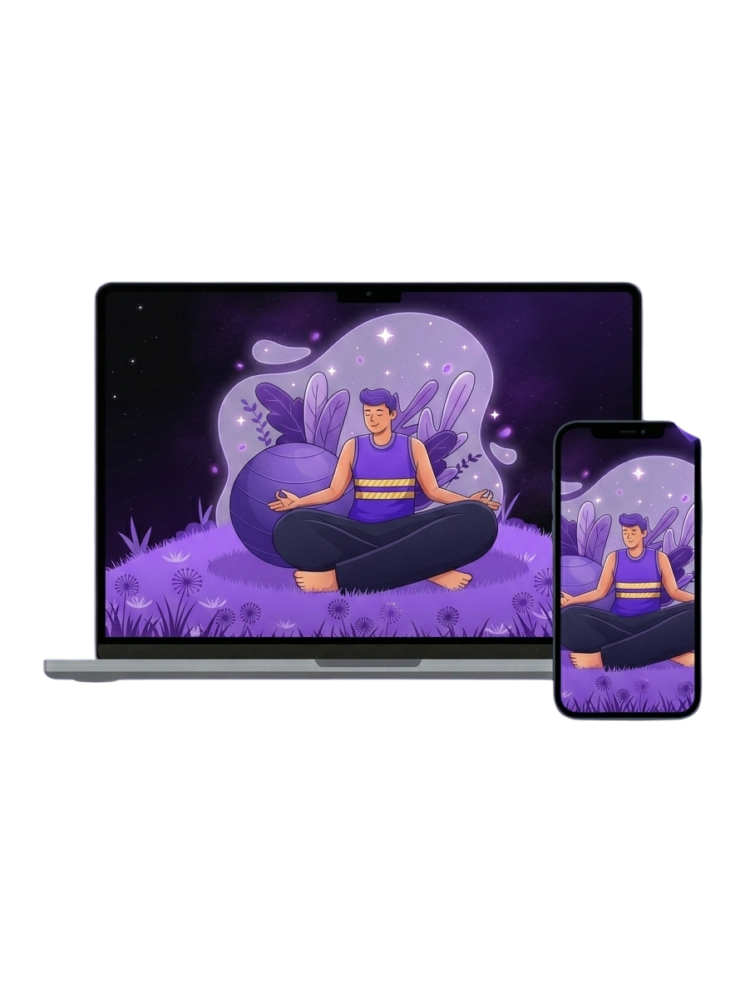
DEPLOYMENT
  Unified Flutter Codebase: One codebase for all platforms
  Mobile App (Android APK): Native Android application.
  Web Deployment (Netlify): Instant browser access, no installation required.
  Cross-Platform Consistency: Same experience across web and mobile.

Slide 26
BUSINESS & MARKET ANALYSIS

Slide 27
COMPETITIVE ANALYSIS
feature | our project ( SafeSpace ) | BetterHelp/ TalkSpace | calm/ HeadSpace | Wysa/Woebot
Bilingual support (Arabic/English) | ✔ | ❌ | ✔ | ❌
Root-Cause Extraction | ✔ | ❌ | ❌ | ❌
Multi-Model Score Fusion | ✔ | ❌ | ❌ | ❌
Crisis Safety Net | ✔ | ❌ | ❌ | ❌
Pricing & Accessibility | Freemium | Expensive &High cost periodic fees | Subscribtion | Freemium

Slide 28
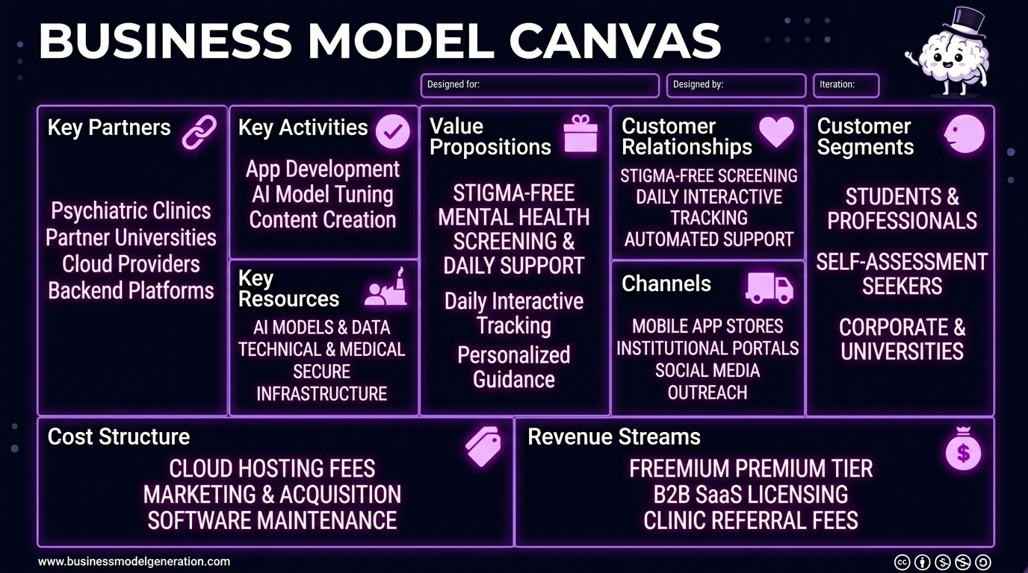

Slide 29
MARKET SIZE
Target Market
Competitive Advantage

Slide 30
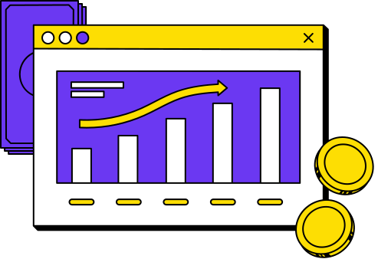
REVENUE MODEL
50%
PREMIUM SUBSCRIPTION PLANS
25%
INSTITUTIONAL LICENSING
15%
THERAPIST REFERRAL PARTNERSHIPS
10%
CORPORATE WELLNESS PROGRAMS

Slide 31
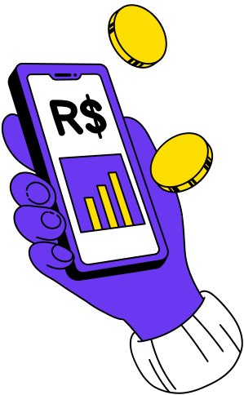
FUTURE
ENHANCEMENT
  Integration with wearable devices.
  Clinical Validation Study.
  Support for additional mental health conditions.
  Voice Emotion Recognition.

Slide 32

CONCLUSION
"SAFESPACE DOESN'T JUST ANALYZE EMOTIONS... IT TRANSFORMS DATA INTO UNDERSTANDING, AND UNDERSTANDING INTO SUPPORT."

Slide 33



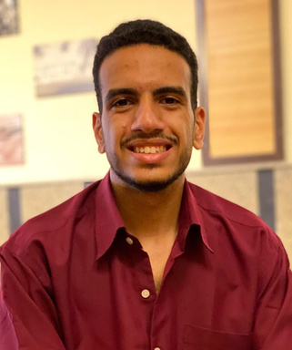





SafeSpace Team
Rowayda El-Bayar
Tasneem Mohamed
Ahmad Behiry
Ali Sakr
Jana Awad
Ali Saad
Youssef Gomaa
Mahmoud Abo Elnaga
Mohamed Sabry

Slide 34

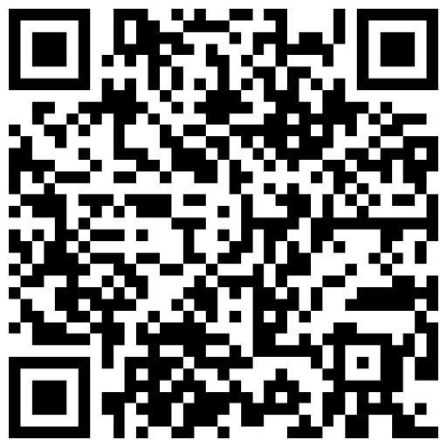

THANK YOU

